Slide 1









My Number Interactive Notebook
$$×$$
$$\frac{1}{2}$$
$$÷$$
$$+$$
$$−$$
$$\frac{3}{5}$$
$$7$$
Name
Class
Teacher
Term 1 Semester 1
$$5^{2}$$
$$\sqrt{9}$$
1

Slide 2
Contents
Glossary or Formula Page
Page
Date
Description
2
3

Slide 3
Tasks
24
7
30
Essential Question
Questions
Notes
Summary

Slide 4
Task

Slide 5
24
7
30
Date
Percentage increase and decrease
EQ – How do I use the decimal multiplier to increase or decrease an amount?
How do I convert a percentage to a decimal?
Percentge → Decimal - divide by 100

Slide 6
We can already do this
Percentage | Decimal
12% | 0.12
33% | 0.33
68% | 0.68
83% | 0.83
20% | 0.2
6% | 0.06
130% | 1.3
12.5% | 0.125
156% | 1.56
0.5% | 0.005

Slide 7
24
7
30
Date
Percentages
EQ – How do I calculate percentages of amounts with a calculator?
How do I convert a percentage to a decimal?
Percentage → Decimal - divide by 100
100% = 1

Slide 8
24
7
30
Date
Percentages
EQ – How do I calculate percentages of amounts with a calculator?
How do I convert a percentage to a decimal?
Percentage → Decimal - divide by 100
100% = 1
How do I increase by a given % without a calculator?

Slide 9
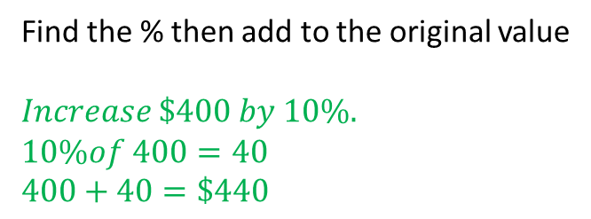
24
7
30
Date
Percentages
EQ – How do I calculate percentages of amounts with a calculator?
How do I convert a percentage to a decimal?
Percentage → Decimal - divide by 100
100% = 1
How do I increase by a given % without a calculator?
Find the % then add to the original value
$$Increase \$400 by 10\%.$$
$$10\%of 400=40$$
$$400+40=\$440$$

Slide 10
24
7
30
Date
Percentages
EQ – How do I calculate percentages of amounts with a calculator?
How do I convert a percentage to a decimal?
Percentage → Decimal - divide by 100
100% = 1
How do I increase by a given % without a calculator?
Find the % then add to the original value
$$Increase \$400 by 10\%.$$
$$10\%of 400=40$$
$$400+40=\$440$$
How do I decrease by a given % without a calculator?

Slide 11
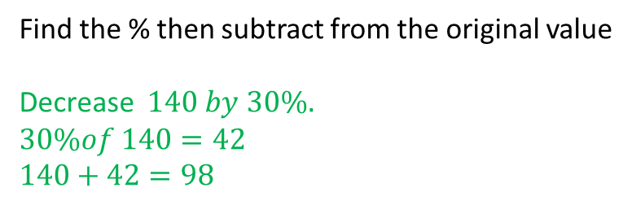
24
7
30
Date
Percentages
EQ – How do I calculate percentages of amounts with a calculator?
How do I convert a percentage to a decimal?
Percentage → Decimal - divide by 100
100% = 1
How do I increase by a given % without a calculator?
Find the % then add to the original value
$$Increase \$400 by 10\%.$$
$$10\%of 400=40$$
$$400+40=\$440$$
How do I decrease by a given % without a calculator?
Find the % then subtract from the original value
Decrease $140 by 30\%.$
$$30\%of 140=42$$
$$140+42=98$$

Slide 12
24
7
30
Date
Percentages
EQ – How do I calculate percentages of amounts with a calculator?
How do I convert a percentage to a decimal?
Percentage → Decimal - divide by 100
100% = 1
How do I increase by a given % with a calculator?

Slide 13
24
7
30
Date
Percentages
EQ – How do I calculate percentages of amounts with a calculator?
How do I convert a percentage to a decimal?
Percentage → Decimal - divide by 100
100% = 1
How do I increase by a given % with a calculator?
Add % to 100% and write as a decimal.
Then multiply the amount by this decimal

Slide 14
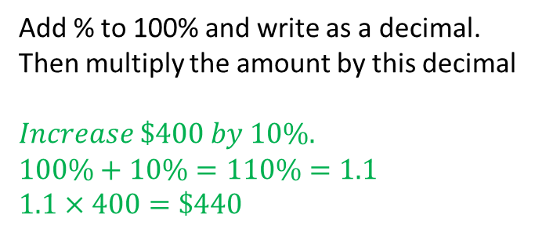
24
7
30
Date
Percentages
EQ – How do I calculate percentages of amounts with a calculator?
How do I convert a percentage to a decimal?
Percentage → Decimal - divide by 100
100% = 1
How do I increase by a given % with a calculator?
Add % to 100% and write as a decimal.
Then multiply the amount by this decimal
$$Increase \$400 by 10\%.$$
$$100\%+10\%=110\%=1.1$$
$$1.1×400=\$440$$

Slide 15
24
7
30
Date
Percentages
EQ – How do I calculate percentages of amounts with a calculator?
How do I convert a percentage to a decimal?
Percentage → Decimal - divide by 100
100% = 1
How do I increase by a given % with a calculator?
Add % to 100% and write as a decimal.
Then multiply the amount by this decimal
$$Increase \$400 by 10\%.$$
$$100\%+10\%=110\%=1.1$$
$$1.1×400=\$440$$
How do I decrease by a given % with a calculator?

Slide 16
24
7
30
Date
Percentages
EQ – How do I calculate percentages of amounts with a calculator?
How do I convert a percentage to a decimal?
Percentage → Decimal - divide by 100
100% = 1
How do I increase by a given % with a calculator?
Add % to 100% and write as a decimal.
Then multiply the amount by this decimal
$$Increase \$400 by 10\%.$$
$$100\%+10\%=110\%=1.1$$
$$1.1×400=\$440$$
How do I decrease by a given % with a calculator?
Subtract % from 100% and write as a decimal.
Then multiply the amount by this decimal

Slide 17
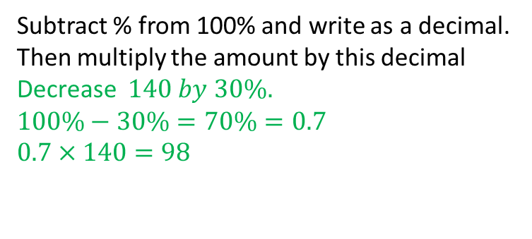
24
7
30
Date
Percentages
EQ – How do I calculate percentages of amounts with a calculator?
How do I convert a percentage to a decimal?
Percentage → Decimal - divide by 100
100% = 1
How do I increase by a given % with a calculator?
Add % to 100% and write as a decimal.
Then multiply the amount by this decimal
$$Increase \$400 by 10\%.$$
$$100\%+10\%=110\%=1.1$$
$$1.1×400=\$440$$
How do I decrease by a given % with a calculator?
Subtract % from 100% and write as a decimal.
Then multiply the amount by this decimal
Decrease $140 by 30\%.$
$$100\%−30\%=70\%=0.7$$
$$0.7×140=98$$

Slide 18
Task

Slide 19
Notes Review
24, 7 ,30
Date
Title
Essential question
Notes complete
Notes complete with colour and diagrams
Questions completed
Contents page filed in
Formula page filled in

Slide 20
Homework
Review your notes and write a summary answering the essential question.

